Slide 1
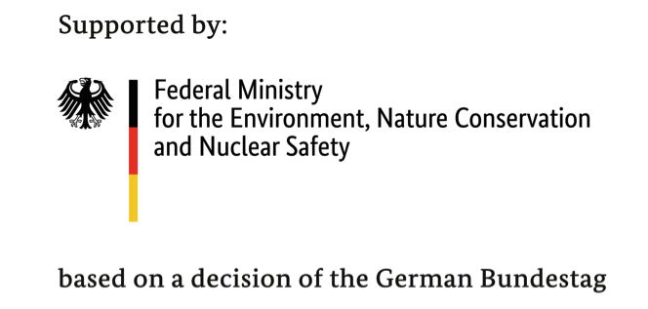
A Roadmap to Green Bonds Readiness
November 2019
Alexia Kelly - Co-Chair, LEDS GP FWG & CEO, Electric Capital Management
Rob Fowler - Training & Advisory Lead, CBI
Olumide Lala - African Programme Manager, CBI

Slide 2

Agenda
Welcome & Overview | Alexia Kelly
Status of the Green Bond Market & How to Get Started with Green Bonds | Rob Fowler
Virtual Demonstration of the Green Bond Roadmap | Alexia Kelly
Sovereign Government Issuance: Case Study: The Nigerian Experience | Olumide Lala
Q & A | Attendees
Wrap-up & Next Steps | Alexia Kelly

Slide 3

Low Emissions Development Strategies Global Partnership
LEDS GP is a network of public and private practitioners and institutions delivering Low Emissions Development Strategies (LEDS) and Nationally Determined Contributions (NDCs) – locally, nationally and internationally.
LEDS GP has growing membership including:
118+ countries, 350+ institutions, thousands of individual practitioners working in national or subnational governments
The LEDS GP Finance Working Group (FWG) supports developing countries in accelerating investment into low emission development through:
  Peer learning & collaboration
  Targeted technical resources & support
  Innovative public private partnerships

Slide 4
IKI MPI - Programme Partnerships
SouthSouthNorth
Climate change NGO based in Cape Town and established in 1999
Long history of successful project delivery in developing countries
Stakeholder management, policy, expert procurement, technical assistance
Climate and Development Knowledge Network (CDKN)
Global programme established in 2010, delivered 1100 projects, 74 countries
Water energy food, climate finance, gender & social inclusion, cities & urban resilience
Led by SSN since 2018
LEDS Global Partnership
LEDS GP Catalyzes Action and Collaboration Across more than 350 Countries and International Organizations and 2500 individual members
Global working groups provide technical support, training, & tools

Slide 5
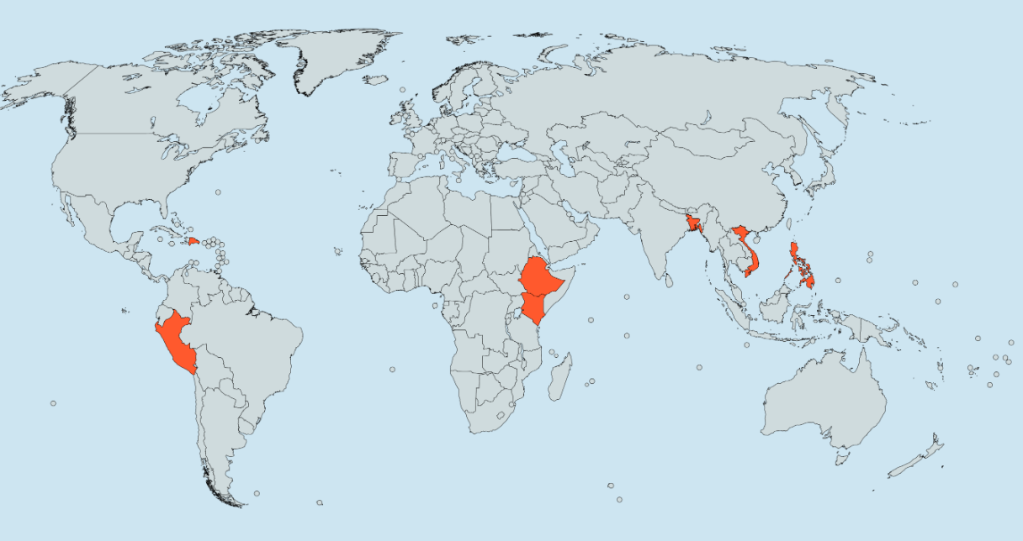

IKI MPI - Mobilising Investment for NDC Implementation
Address barriers and levers
Identifying opportunities for scaling up private investment
Developing investment measures for priority sectors
Expand the pipeline for investment
Document and apply the learning
Bangladesh
Dominican
Republic
Vietnam
Philippines
Peru
Ethiopia
Kenya
Notes:
Hi everybody
This webinar will commence shortly – waiting for any last minute attendees to join us.
This is the first webinar in the series for the programme ‘Mobilising Investment for NDC implementation’. The programme is funded by the German government under the International Climate Initiative and is a collaboration between SouthSouthNorth who are the lead organization, based out of Cape Town
PwC in London
NREL – the National renewable Energy laboratory in Denver, USA
ODI in London
The next webinar is scheduled for mid June and will cover Integrated Governance in Peru.

Slide 6
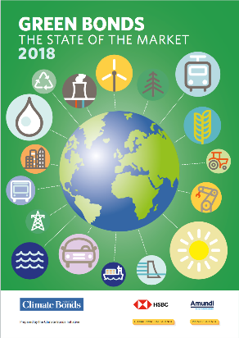

The Climate Bonds Initiative
CBI is an investor-focused NGO mobilising debt capital markets for climate solutions.
Market intelligence
Green bonds data base, feeding indices everywhere
State of the market reports, global and regional
Climate Bonds Standard & Certification Scheme
Definitions for investors and guidelines for bond issuers
  Assurance through certification
  Demonstration of robust labelling
Policy advisory
Policy models and advice for govermnents and regulators
Efforts in emerging markets to grow issuance
Green innovations e.g. securitization, covered bonds, Islamic Finance
Capacity building
Developing local expertise to issue, arrange and invest in green bonds

Slide 7
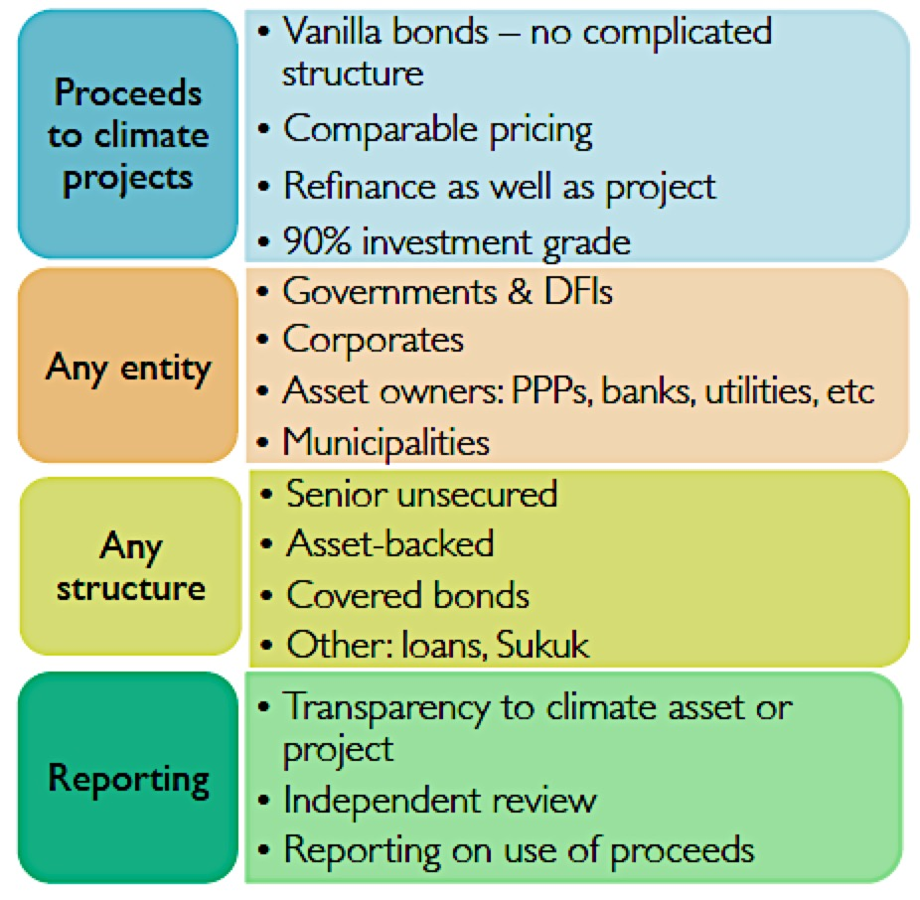
Green Bonds Explained
Green bonds are debt securities issued by financial, non-financial or public entities where the proceeds are used to finance 100% green projects and assets
Just like regular vanilla bonds. “green” is a bonus feature to the bond.
It’s about the projects and assets, not the issuer.
The green label is a tool for investors
Source: Climate Bonds Initiative 2018

Slide 8
Green bonds can shift financial markets to green
Global financial markets
$90trn bond market
Investors are seeking yield
Record low interest rates
Investors want green:
  $60trn investor commitment at UN Climate Summit
  Insurers commit to increase climate investments 10x by 2020
Green Bonds:
Tool to shift debt capital markets to climate solutions
Climate mitigation and adaptation requirements
Paris agreement to keep temperature rise below 2 degrees
IEA: Energy sector requires $53trn by 2035
$93trn required by 2030 across all sectors
Source: Climate Bonds Initiative 2018

Slide 9

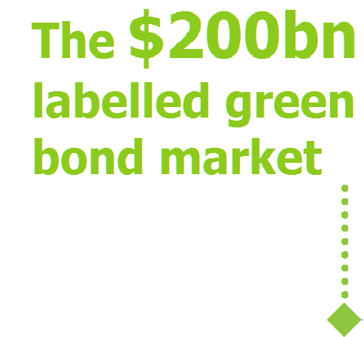
Capturing global flows – just getting started
$616bn
$1.06tn other climate-aligned
bonds
Outstanding, 12/6/19
Outstanding, end June 2018
$1tr labelled green bonds by 2020
(Christiana Figueres)

Slide 10
Green Bonds are growing fast globally
USD171bn in 2018
USD188bn in 2019 so far
Cumulative issuance to date: USD705bn
56 countries now
4 new markets in 2019: Russia, Barbados, Panama and Kenya
822 issuers to date
  165 debuts in 2019
  222 debuts in 2018

Slide 11
Corporate and Sovereign Issuance is Growing
Key players:
Development banks
  Initiated green bond market. Still active in Emerging Markets
  EIB is largest issuer
  IFC now mainly EM GB investor
Corporate sector
  Financial corporates now engaging as issuers
SSA sector
  Government backed entities particularly important issuers – ABS issuance enhanced by Fannie Mae Green MBS
  Sovereigns raising their game: 2018 debut deals from Indonesia, Belgium, Lithuania + repeats from Poland, France

Slide 12
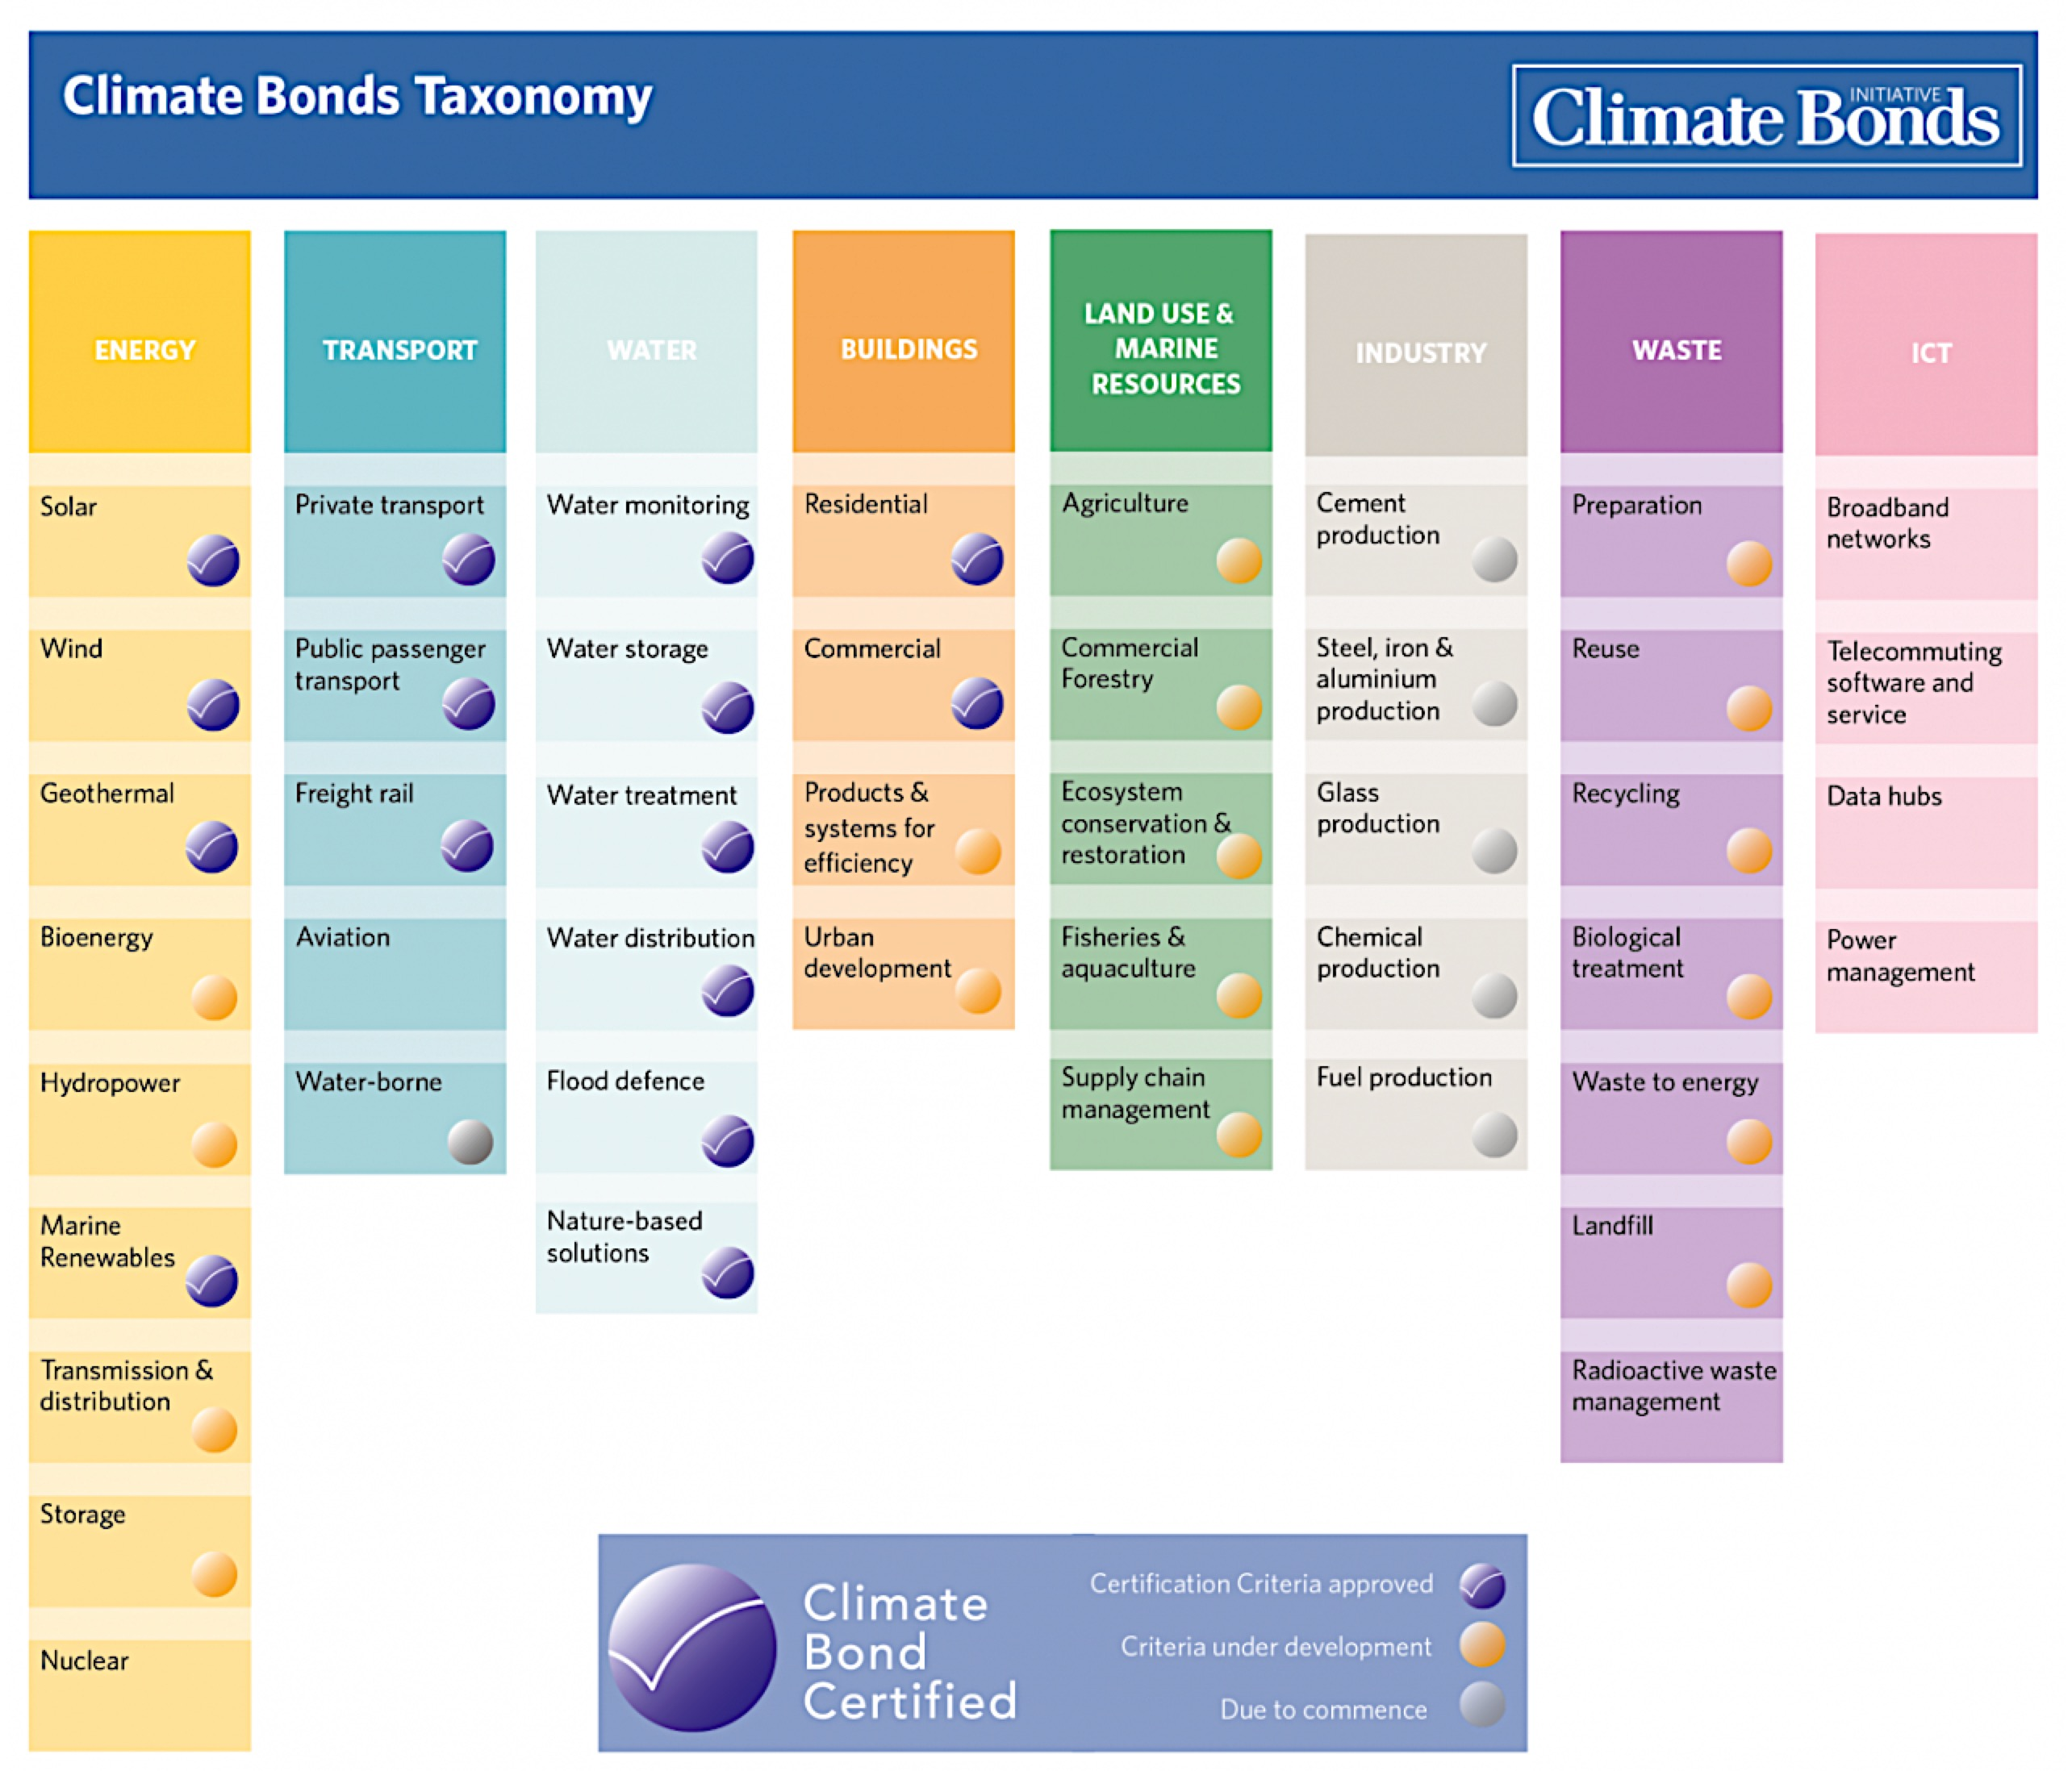
What is Green?

Slide 13
What are the benefits for issuers?
Investor diversification – low-carbon integrity of the bond attracts a much broader base of investors, which Treasurers see as valuable
Lower cost of capital – green bonds enable issuers to raise large amounts of capital to support environmental investments and push the pricing of that capital to the lowest levels possible within capital market constraints
High oversubscription – strong demand for green bonds generally outstrips supply, creating opportunities through deal upsizing and reverse inquiries
Stickier Pool of Investors – Green Bond Investors invest for the long term, matching maturity with project life, and will sell out of green bonds last
Tighter yields – there is a view that stronger pricing will be achieved for future green bond issuance, particularly as incentives for green finance flourish
Green flavor – enhances issuer reputation, including equity values (if recent analysis of the “green halo” effect can be extrapolated)

Slide 14
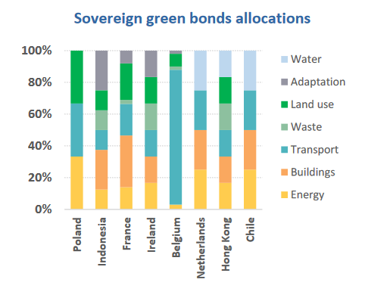
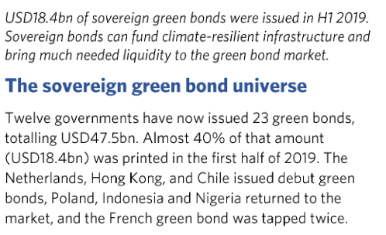
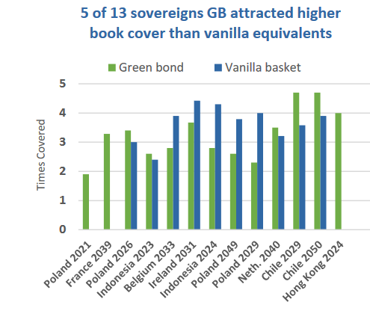
Sovereign Green Bonds
NDC Financing, market signaling, increased funding

Slide 15
Sovereign green bonds – why issue?
Benefits:
Raising capital to finance infrastructure in line with its national contribution to meeting the goals of the Paris Agreement
Attracting new investors
Providing policy certainty
Improving collaboration between ministries
Drawing international attention to its environmental policies
Impact of sovereign green bonds:
Kick-starting a domestic market
Providing scale and liquidity to the green bond market
Using signalling power to other market stakeholders
Diversifying the green bond market/tapping into new investor segments

Slide 16
Different regional green bond policy tools are already in place or soon to commence
Region/Country | Policy | Year | Issuing Body
European Union | TEG recommendations (more later) | 2018, 2019 | EU Commission
Hong Kong | Green Bond Standards | 2018 | HK Quality Assurance Agency
China | Green Bond Catalog Guidelines Green Bond Assessment, Verification Guidelines (more later in China section) | 2015 2017 2018 | People’s Bank of China, NDRC China Securities Regulatory Commission Green Bonds Standard Committee
ASEAN | Green Bond Standards | 2017 | ASEAN Capital Markets Forum
Singapore | Subsidising cost of external reviews | 2017 | Monetary Authority of Singapore
Nigeria | Green Bond Guidelines | 2017 | Nigerian Securities Exchange Commission
Kenya | Green Bond Programme | 2017

Slide 17





Global Green Bond Partnership
The Global Green Bond Partnership brings together pioneering organizations and institutions working on green bonds to scale their issuance by public and private partners in both developed and emerging markets globally.
Founding Members
Themes of Engagement 2019
Market Promotion & Advancement
Technical Standards & Norms
Coordination & Collaboration

Slide 18
The Green Bond Roadmap
A resource for corporate and government representatives and others interested in better understanding green bonds
Provides users with a basic outline of green bonds and their role in mobilizing capital for climate change action
The Green Bond Roadmap
https://www.globalgreenbondpartnership.org/about-us

Slide 19
Case Study: Apple
Issuances to Date: 2 -- 2016 + 2017
Total Debt Issued: USD 2.5bn ($1bn followed by $1.5bn)
Use-of-Proceeds: Clean energy + environmental projects + enhanced recycling and supply chain improvements + energy efficiency + green buildings + resource conservation
The company has committed to powering all of its facilities with 100 percent renewable energy. In addition, together with its suppliers, Apple has a commitment to bring more than 4 gigawatts of new clean power online worldwide by 2020.
2nd Party Opinion: Sustainalytics
Annual Auditing: Ernst and Young

Slide 20
Case Study: Starbucks
Issuances to Date: 3 -- 2016 + 2017 + 2019
Total Debt Issued: USD 1.5bn + JPY 85bn
Use-of-Proceeds: Ethical Coffee Sourcing + Greener Retail Initiative
  Portion of the funds will support a new $20 million investment in responsAbility Investments AG as part of Starbucks Global Farmer Fund that supports coffee farmers and their communities
2nd Party Opinion: Sustainalytics

Slide 21

Nigerian Green Bond Case Study

Slide 22
Institutional Framework

Slide 23
Institutional Framework
Selection process for eligible green expenditure
An Inter-Ministerial Committee on Climate Change has undertaken the selection of Eligible Green Expenditures
Selection Process for the Eligible Green Expenditures
Nigeria Government Budget
Supervisory agencies
Screening based on budget documents and ministry of Environment Green Bond Guidelines
Ministry of Finance
Ministry of Environment
Potential Green Bond Projects
Inter-Ministerial Committee on Climate Change
Assessment by Green Bond Program Technical Advisory Team
Ministry of Power
Ministry of Environment
Potential Green Bond Expenditure
Final validation
Ministry of Finance
Ministry of Environment
Eligible Green Expenditure
The Green Bond Guidelines have been used as a guiding reference for the selection process, as well as the target in the NDCs. Each ministry has been responsible for identifying eligible green expenditure within its programmes. The Inter-ministerial Committee on Climate Change has excluded activities that do not comply with CBI certification standards.

Slide 24
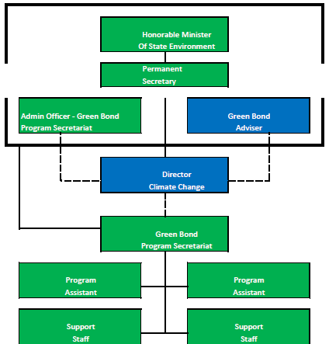
Green Bond Secretariat

Slide 25
Technical Review Approach

Slide 26
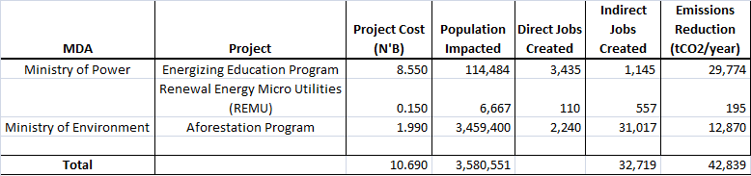
Project Metrics

Slide 27
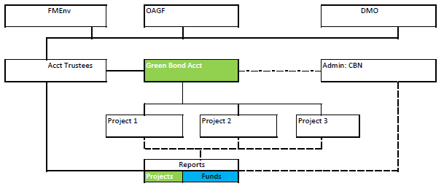
Green Bond Account Structure

Slide 28
Outputs
Green bond guidelines
Green bond framework
Rules for issuance of corporate and sub-national bonds (capital market regulator)
Project review summaries/profiles/targets
Second opinion (CBI Certification/Moodys Assessment)
Periodic reports on implementation progress measured against targets

Slide 29
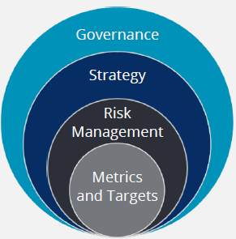
Nigeria Green Bond: Summary
Governance
Established multiple structures to manage the inter government/capital market relationships needed to progress issuance
Strategy
Project review documents prepared outlining the approach to project implementation to achieve economic, climate & social impacts
Risk Management
Weak at this early stage considering steep learning curve
Metrics and Targets
Emissions savings compared to targets in the NDCs along with economic metrics

Slide 30
Q & A
Q & A from the audience
Wrap-Up & Next Steps
Alexia Kelly, alexia@electric.capital
Rob Fowler, rob.fowler@climatebonds.net
Olumide Lala, olumide.lala@climatebonds.net

