Slide 1
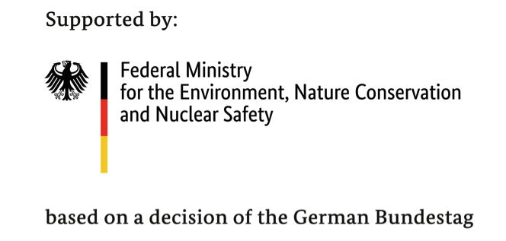
A Case Study for Integrated Climate Governance:
Aligning Kenya’s County Integrated Development Plans with National Climate Change Action Plan
March 2020
Mobilizing Investments for the Implementation of NDCs - Learning Theme #3 - Integrated Governance
Scott Muller - IKI MI Governance Specialist
Edna Odhiambo - IKI MI Country Lead
Carren Nasiaki Kirungu - County Land Reclamation Officer, Ministry of Environment, Water and Natural Resources in West Pokot County
Anam Moturi - Head Climate Change Management, County Government of Nyamira

Slide 2
Agenda
Welcome & Overview | Scott Muller
Introduction | Edna Odhiambo
Climate change investment priorities of the Nyamira County Integrated Development Plan (CIDP) | Anam Moturi
How the 'investment priorities of the CIDP are linked to the NCCAP' in West Pokot county | Carren Nasiaki Kirungu
Q & A Poll | Attendees Attendees

Slide 3
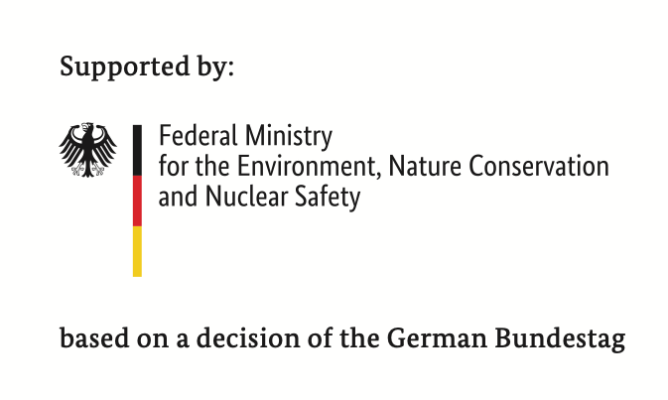



Mobilizing Investments for the Implementation of NDCs
Learning Theme #3 - Integrated Governance
Successful public investment requires co-ordination between national and subnational governments. Effective multi-level governance (MLG) and intersectoral collaboration are key components of successful low emission, climate-resilient development strategies.
Background:
The trans-institutional relationships between the different levels of authority in a country is critical to shaping the global capacity to govern climate change.
Successful public and private investment requires co-ordination between national and subnational governments.
Integrated governance is a foundation for successfully scaling investments to achieve the NDCs.

Slide 4
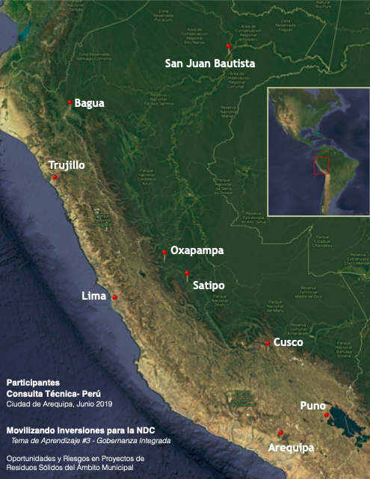
Mobilizing Investments for the Implementation of NDCs
Learning Theme #3 - Integrated Governance
Peru
Valorization of Solid Waste at the Municipal Level
Institutional Mapping Report
Domestic Technical Consultation Report
Spotlight Interviews
  Satipo
  Cusco
  Oxapampa
Webinar

Slide 5
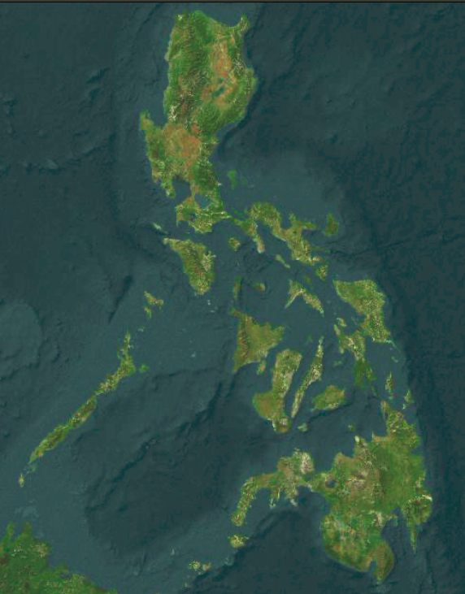
Mobilizing Investments for the Implementation of NDCs
Learning Theme #3 - Integrated Governance
Penablanca
Philippines
Abra
San Fernando
City
Sta. Maria Bulacan
Implementation of the
Energy Efficiency & Conservation Act
by Local Government Units
with Department of Energy
& PLLENRO
Institutional Mapping Report
Domestic Technical Consultation Report
Spotlight Interviews
Webinar
Guiguinto
Imus City
Santa Rosa
Batangas
Sorsogon
Catbalogan
City
Iloilo
City
Cadiz City
Agusan del Sur
T’Boli

Slide 6
Mobilizing Investments for the Implementation of NDCs
Learning Theme #3 - Integrated Governance
Kenya
Aligning County Integrated Development Plans to the National Climate Change Action Plan
Institutional Mapping Report
Domestic Technical Consultation Report
Spotlight Interviews
  West Pokot County
  Mandera County
Webinar
Mandera
West Pokot
Nyamira
Lamu
Laikipia

Slide 7




A Case Study for Integrated Climate Governance:
Aligning Kenya’s County Integrated Development Plans with National Climate Change Action Plan
Aligning County Integrated Development plans to the National Climate Change Action Plan: Kenya Case Study

Slide 8
MULTILEVEL GOVERNANCE ON CLIMATE CHANGE IN KENYA
Climate Change legislative framework
Devolved Governance- 47 Counties (sub-national level)
County Government functions and climate change
Counties’ duty to Mainstream climate change into planning budgeting and implementation

Slide 9
County integrated development plans
Why are CIDPs pivotal in driving climate action?
What are the barriers that stunt alignment of CIDPs with NCCAP?
What support can be leveraged across various governance levels to support effective development of climate-smart indicators in the CIDPs?

Slide 10
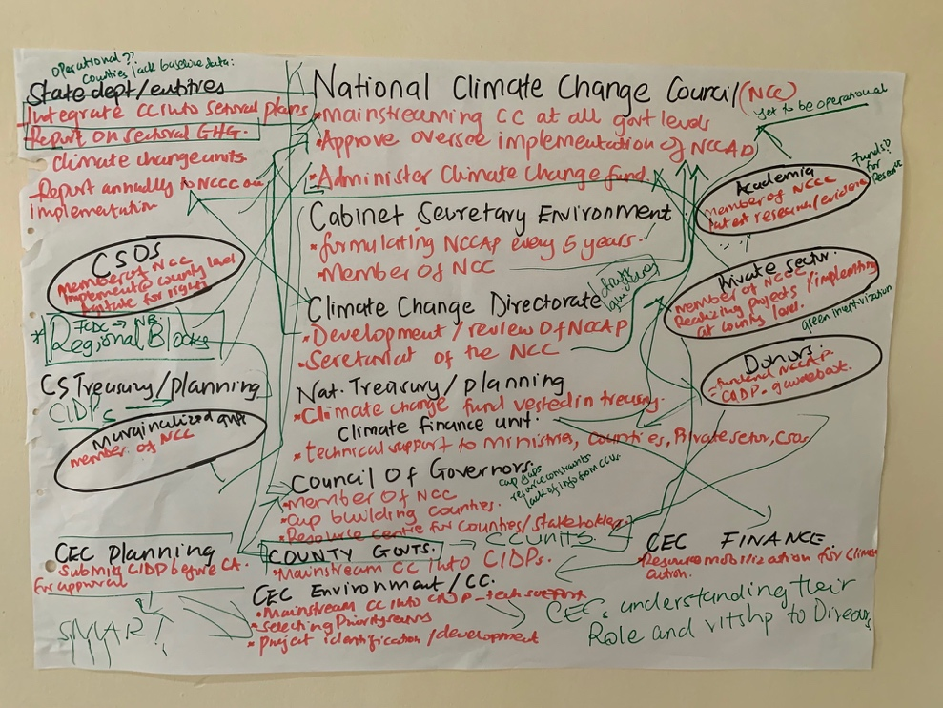
MAPPING ACTORS

Slide 11
Challenges
Lack of Data
Siloed Approaches
Financial Resource constraints
Human Resource constraints
Politics
Bureaucracies

Slide 12
RECOMMENDATIONS
Establishing Climate Change Units at County Level- coordination, finance and mainstreaming
Central data information sharing intra-county and coordination with national entities
Leveraging the power of Regional Blocs
Aligning funding to timely climate change action

Slide 13
CLIMATE CHANGE INVESTMENT PRIORITIES OF THE NYAMIRA COUNTY INTEGRATED DEVELOPMENT PLAN(CIDP)
PRESENTATION BY: ANAM MOTURI
NYAMIRA COUNTY head CLIMATE CHANGE management

Slide 14
Table of Contents
CIDP 2018-2022 Major Interest
Institutional Framework

Slide 15
CIDP 2018-2022
Major Interest area are:
Legislation
Wealth creation through waste recycling
Food Security and Nutrition
Afforestation & Reforestation
Green Energy
Water Security
Human Health
Climate Change Information Services

Slide 16
Nyamira County Climate Change Legislation
Preparation of Environmental Policy which is in progress and awaiting adoption by the County Assembly
Draft climate change policy in preparation
Establishment of Climate change Unit being considered by Cabinet
The legislations provide legal backing for grants and investor entry point

Slide 17
Wealth creation through waste recycling
The county produces 18,000 tonnes of garbage per year
The CIDP 2018-2022 outlines programme for establishment of energy generation plant that harness industrial and household waste material into energy sources providing electricity by addition to the National energy grid.
Separated waste provides for recycling of bottles, plastics and metals
Bio degradable materials provide a source of organic fertilizer reducing use of inorganic fertilizer
Biogas generation for domestic use
Waste recycling therefore offers an untapped investment opportunity for the county

Slide 18
Food Security and Nutrition
Land degradation is a precursor for climate change, majorly brought about by extraction of natural resources for development for example quarrying ,brick making however economical these activities are, they contribute to soil degradation hence insufficient agricultural output.
Because of productive land shortage, the CIDP proposes land management practices that will utilize the little space and at the same time optimize output.
Agroforestry can be practiced by ensuring the cultivation of fruit tree in farm lands, this increases food production and hence healthy population
Avocado, guava, mangoes and oranges among other fruit trees when grown will provide income to small holder farmers, enhancing food security and reduction of soil erosion.

Slide 19
Food Security
Kaliadra and cassava tree planted in farms control erosion and provide nutritious livestock feed
County can harness the National Government agreement with China and Europe on large scale production of hass avocado hence increase of small holder farmer income.
Agroforestry is major contributor to National Government policy of 10% forest coverage
Promotion of Crop diversification as a way of moving from outdated cultural practices
Establishment of greenhouse to enhance output of horticultural crops this model works well in areas of rainfall inconsistencies

Slide 20
Afforestation & Reforestation
CIDP proposes programme for planting diverse species of trees on hill tops in order to control soil erosion, source of rainfall catchment and to provide temperate temperatures.
Reducing deforestation and degradation
Clean development mechanism result in net greenhouse gas removal(carbon sinks)
Support establishment of tree nurseries by youth groups and promotion of tree planting in schools colleges and open spaces in urban centres
Construction of contours along sloppy farms to reduce soil erosion provides an opportunity to SMART agricultural Technologies to set up base in Nyamira county.

Slide 21
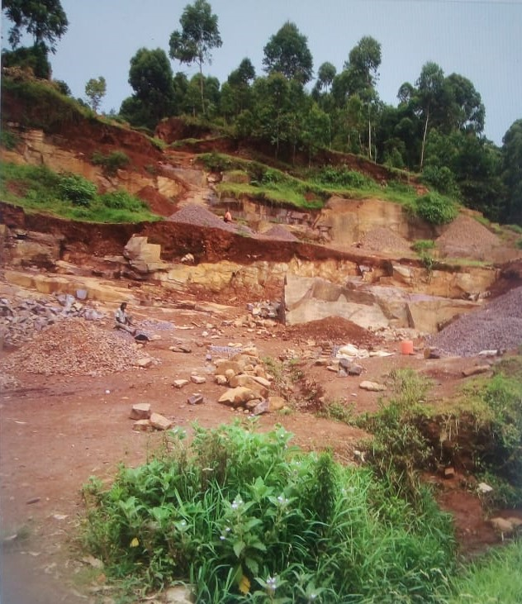
Pictorial

Slide 22
Water Security
Executive order issued by H.E the Governor on removal of Eucalyptus trees on riparian lands and water catchment areas ensures that water sources are preserved.
Replacement of Eucalyptus trees along river banks with bamboo and indigenous trees will ensure conservation of water sources, water recharge and clean safe water .
Local and external investors can take opportunity to provide farmers and growers with needed seedlings
Policy on Rain water Harvesting to maximize rain water harvesting and storage for commercial and household use. This will ensure water security for Nyamira county residents
Change in rainfall patterns calls for alternative water sources. Borehole drilling and spring water protection offers an alternative water supply (Adaptation)
Construction of Dams and water pans at Nyansiongo and Magwagwa in order to mitiate on rainfall shortages.

Slide 23
Green Energy
Nyamira is resource reach in terms of renewable energy
This can be harnessed by establishment of home solar facilities hence provide lighting and heating services.
Home solar reduces expenditure on gas and serves as a tool for reduction of use of wood log as fuel hence reduction of greenhouse gas emission and deforestation
Home solar provides affordable energy for the community
Solar street lighting being a major investment area offers a viable sustainable investment opportunity to prospective investors.
Biogas can be generated from biodegradable material hence lowering cost of energy for homes.

Slide 24
Human Health
Clean environment contributes to reduction of disease causing chemicals and microorganisms.
Stagnant water breeds mosquitos hence causing malaria to citizens effective climate management reduces medical expenses
The use of wood fuel leads to chest related diseases. Biogas use and solar generated energy sources lower disease incidences to citizens

Slide 25
Climate Change Information Services
Traditional methods of rainfall forecasting such as birds, birds, tree ,ants provided indication of seasonal changes unlike the present time
Traditional rainfall makers are no more,
The above situation calls for establishment of a modern metrological department in the County to give timely and reliable information on rainfall patterns. current information is obtained from Kisii County.
Establishment of the metrological centre is 20m

Slide 26
Institutional Mapping
GOVERNOR
COUNTY EXEUTIVE COMMITTEE MEMBER
COUNTY ASSEMBLY
CHIEF OFFICER
COMMITTEE ON ENVIRONMENT/CLIMATE CHANGE
SECRETARIAT

Slide 27
Thank You

Slide 28
A Case Study for Integrated Climate Governance: Aligning Kenya’s County Integrated Development Plans with National Climate Change Action Plan
How the 'investment priorities of the CIDP are linked to the NCCAP' in West Pokot County
Prepared by:
Carren Nasiaki Kirungu (Msc.Envt.Mgt)
County Land Reclamation Officer
West Pokot county
Email: cnasiaki@gmail.com
Cellphone:0726761561

Slide 29
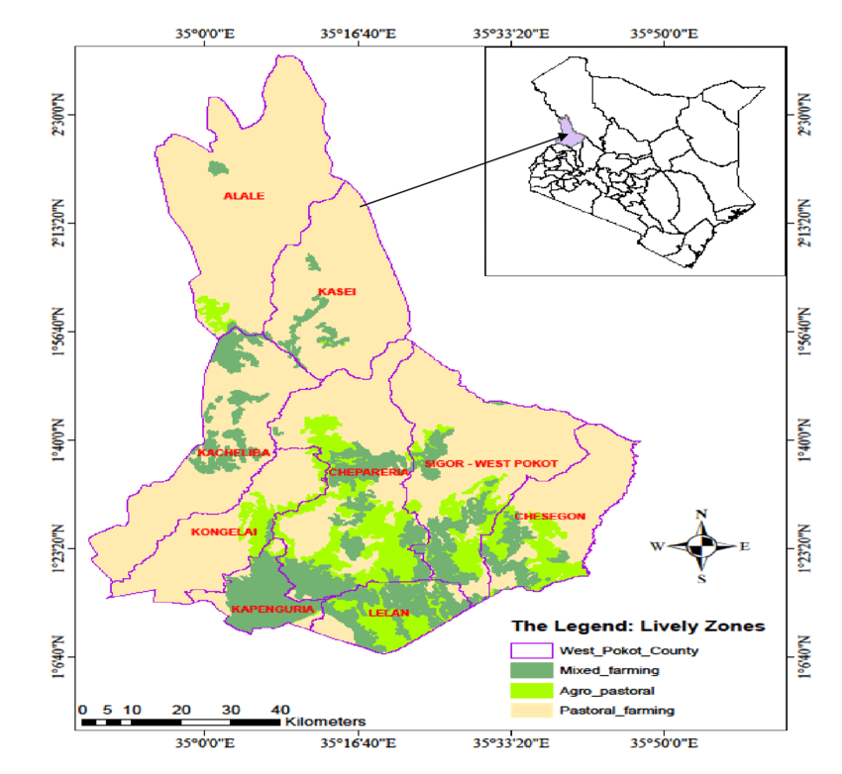
WEST POKOT COUNTY
FACTS :
74.5% arid and semi arid
covers 9,169 square km, of which 41% is arable (Gok, 2013).
Irrigation is used by 1.4% of the households.

Slide 30
Climate Change and land degradation in West Pokot
The county is 74.5% ASAL, with a forest cover of only 3.9%, a fragile ecosystem, with low investment in environmental goods and services. This increases the county’s vulnerability to climate change. Poverty levels currently stand at 57.4 percent (KIHBS, 2016) and livelihood economy is highly pastoral and dependent on natural resources (pasture, water, Fuel wood, timber, wild fruits,) which are sensitive to climatic conditions.

Slide 31
Climate Change and land degradation in West Pokot
In many areas of West Pokot County the lands are rapidly degrading due to climate change and anthropogenic factors. The effects of overgrazing, deforestation and unsustainable agricultural practices are amplified by the entrenched drought and flood cycles. These climatic conditions are in turn affecting human activity. For example, the severe drought drives overgrazing and pushes farmers to shift to riparian cultivation resulting in these areas being prone to soil erosion. Due to increased economic pressure, many households are burning and trading in charcoal and wood, leading to increased deforestation. Loss of tree cover renders soils more vulnerable to intense rainfall events. Coupled with overgrazing and increased pressure on the land, deforestation is leading to massive scale erosion, both surface soils and deep gully erosion.
The long rain season in the region traditionally begins in March, through to August. These reliable rainfall patterns no longer occur, as illustrated by the 2019 patterns: where the rains were delayed until June, followed by very short rains between October and December. Then in December, West Pokot County experienced sudden torrential rainfall followed by flash floods which resulted in landslides. Many people lost their homes and lives were lost. Others lost their means of livelihood. Roads and bridges were also destroyed.

Slide 32
Climate Change and land degradation in West Pokot
    Incremental advancing land degradation is also driven by climate change, resulting in lower cropping potential and loss of other ecosystem services. Severe cascading indirect impacts create issues of food security which in turn, contributes to the breakup of family units and puts pressure on education and health services.
    Understandably these stresses result in increased conflict among neighboring communities (Marakwet, Turkana Karamojong, and Sebei for example), between counties (West Pokot, Turkana, Elgeyo-Marakwet, and Baringo); and even between countries (Uganda and Kenya).

Slide 33
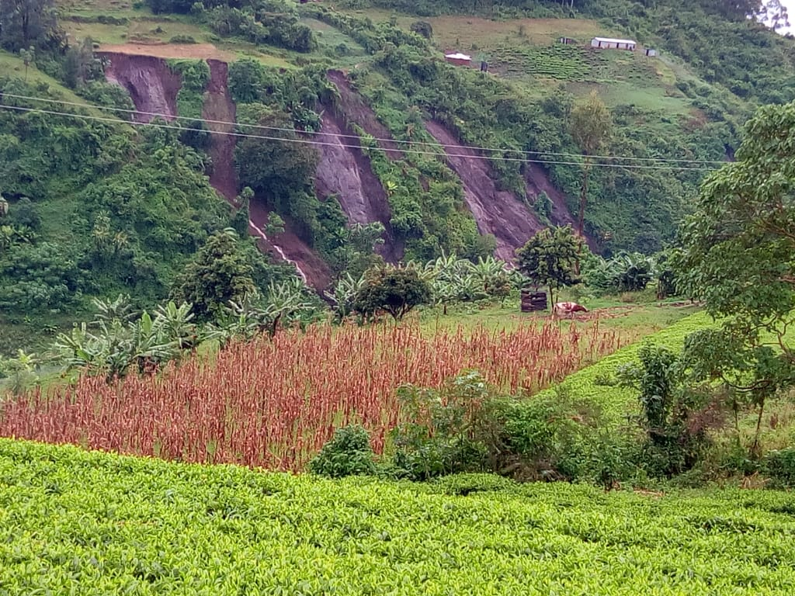
Climate change impacts- landslide in Pokot central in December, 2019

Slide 34
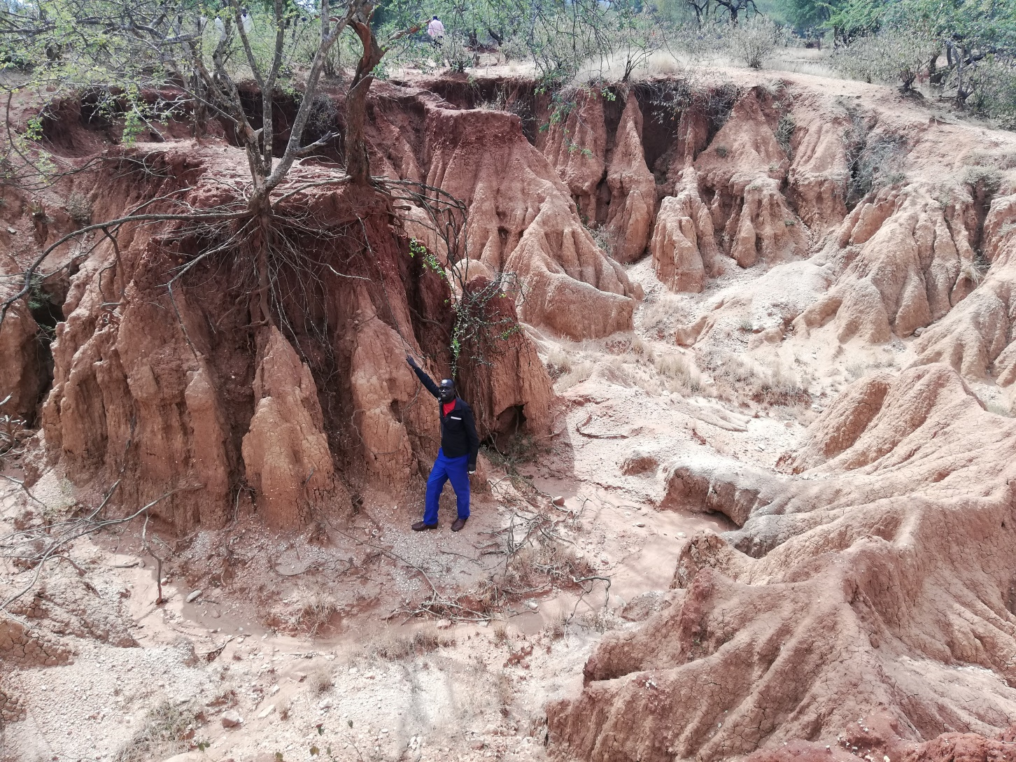
Severe soil erosion in Emboasis primary in West Pokot County(Jan,2020)

Slide 35
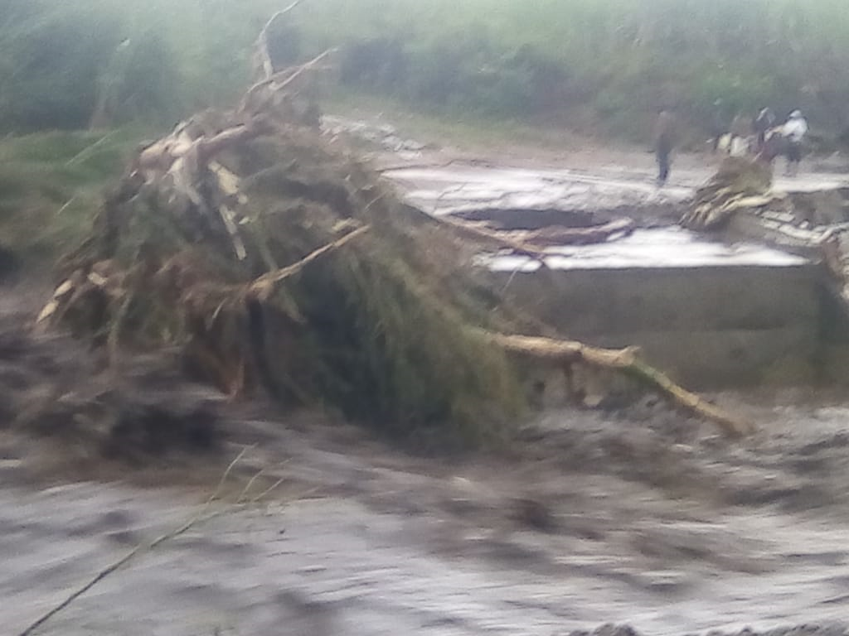
Flooding in river Weiwei in December,2019

Slide 36
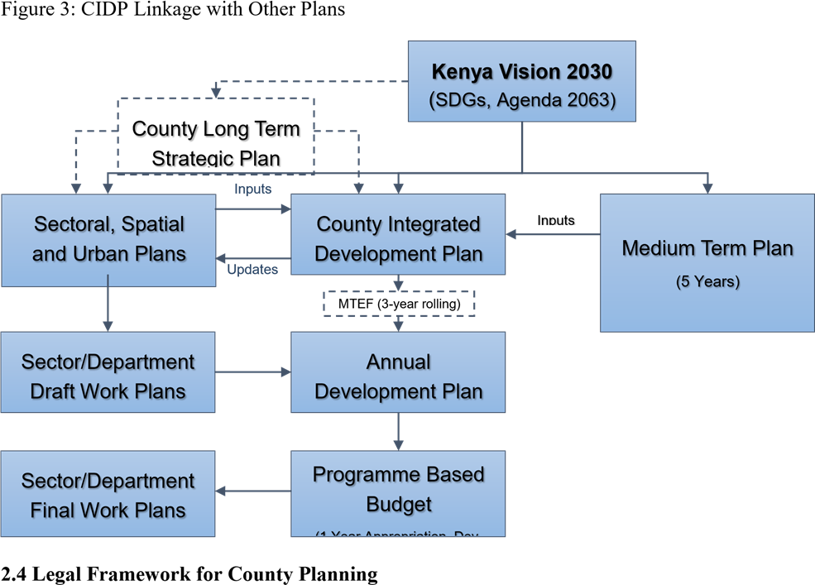
CIDP LINKAGES WITH OTHER PLANS

Slide 37
CIDP LINKAGE WITH THE NCCAP
The West Pokot County CIDP is indirectly linked to the NCCAP. However, it is linked to many other plans as illustrated in the previous slide. Though there is need to directly link it to the NCCAP.
Through the 2018-2022 CIDP, Many projects addressing climate change impacts have been identified and documented. However, there exists challenges in fully implementing the priority areas.

Slide 38
Governance challenges
The climate change policy and bill has not been domesticated by the county assembly
Low funding on climate smart initiatives
Untimely/ late funding hindering successful implementation of projects that depend on weather/ climate
Uncoordinated efforts among the key players
Inadequate knowledge among the key actors and stakeholders on mainstreaming the climate change agenda/ the harmonized climate change indicators.
Political interference.
Inadequate dissemination of the relevant information to stakeholders
Insufficient funds for mainstreaming climate change in the county since it is usually not factored in the budget.

Slide 39
Funding challenges for adaptation efforts on the ground
The County Land Reclamation Department notes that there are many opportunities identified by communities for erosion control and reforestation, which would improve soil conservation. These measures should ideally be planned and implemented before the rains. However, one of the main challenges the county has to solve is the late disbursement of public funds. Un-coordinated financial disbursement complicates the implementation of SMART climate projects and makes it difficult to plan for harmonized, pro-active approaches.
Another challenge is insufficient funding. Many projects and important opportunities are identified and are aligned with the County’s Integrated Development Plan (CIDP) and in the Annual Development Plan (ADP). But only one of about twenty projects are implemented in a year due to many competing priorities and shortage of funds – noting that the responsible ministry (water, environment and natural resources) where the department falls is also responsible for water-related projects and is under financial pressure as well as being “over-subscribed” with requests for capacity and funding.
The budget for the Land Reclamation Department can go as low as Ksh 1,000,000 (+/- US$ 10,000) for one financial year— which is extremely limiting. For example, this creates basic transportation challenges in the department, and makes it very difficult to properly supervise the implementation of projects.

Slide 40
Funding challenges for adaptation efforts on the ground
West Pokot County designed a drought resilience solution to plant and harvest pasture in the degraded areas and store the hay for pastoral communities during the drought season. But inadequate hay storage facilities precluded the strategy from being realized. Access to a mower and baler for harvesting have also posed a challenge. Currently, the county relies on the Livestock Improvement Project in Nasukuta region to assist with the necessary mower and baler for harvesting, but this creates delays for up to 2 years. This inefficiency makes proper harvesting a problem.

Slide 41
Funding challenges for adaptation efforts on the ground
Severe gully erosion is becoming more common on public lands and there are several schools and health services infrastructure that are threatened by the advance of gullies towards their foundations. There are several instances where the county has identified opportunity to plant pasture and reverse gully degradation, but cannot access funding to do so. In the current financial year one gully control programme will go ahead funded by the Land Reclamation Department at Emboasis Primary school, where 60 acres around the school are riddled with unsafe gullies. The project type falls within the CIDP pipeline, and despite the critical importance to address this issue (or face the consequent loss of building infrastructure) this year’s funding will be insufficient to adequately address the issue.

Slide 42
Funding challenges for adaptation efforts on the ground
Suffice to say, there are a myriad of interventions that have been identified across the county, many included within the CIDP which await finance. When sustainable land reclamation solutions are so difficult to get off the ground, people become more concerned with immediate priorities, such as sinking boreholes for access to water.

Slide 43
Integrated Solutions required
Building technical capacity and awareness of officials is important because land degradation is a complex interdisciplinary subject and requires a myriad of complementary interventions to address and reverse. Members of the County Assembly (MCAs) thus benefit from greater technical understanding. Communities would also benefit from education and capacity building on the impacts of climate change, the inter-related causes of land degradation, and opportunities for adaptation. However, implementation projects and capacity building priorities can compete with one another for funding. While there are strong benefits to capacity building in the Department, there is urgent demand for critical infrastructure to improve resilience on the ground and realise immediate and direct benefits (noting the proposal for pasture storage in West Pokot, for example, which is hampered by lack of finance for storage facilities, mowers and bailers).
Raising Awareness at national level could also assist in the process of policy adjustment, where required, and enable the public expenditures and investments necessary to make land degradation intervention strategies more effective and transformative.

Slide 44
Opportunities for improved integration of climate governance
A clear Climate Action Policy could provide a solution for West Pokot County, to guide the county towards achieving national targets and in turn, generating local benefits. To date, the climate policy and bill has not been adopted by the county assembly. Broader solutions, such as funds for mainstreaming climate change in the counties, are not factored.

Slide 45
Opportunities for improved integration of climate governance
What is clear however, is that greater coordination among key players delivers improved results. For example, once short term strategies are in place to support land recovery (through afforestation and pasture rehabilitation) the Land Reclamation Department seeks to collaborate closely with the Livestock Department to improve breeds, and mitigate over stocking and overgrazing— thereby attenuating one of the tangible drivers of land degradation.
Technical workshops for MCAs would help sensitize and build understanding on climate change matters, and the impacts of, and opportunities to control land degradation. In the short term, in order for West Pokot to attract more public and private investment in the long list of identified climate projects— the projects already included within the CIDPs, should be then included in the ADPs. This will help fast-track projects, and avoid postponing important projects indefinitely

Slide 46
Thanks for listening attentively
ANY QUESTIONS?

Slide 47

Questions

