Slide 1
NDCs are at the heart of the Paris Agreement
They outline countries’ climate action plans
“Much of the ambition in developing countries’ NDCs is conditional on receiving finance support”
“Finance flows are not sufficient to fund developing country NDCs.”
“Large scale renewable energy and low-carbon transport projects receive the majority of tracked climate finance flows”
Given the urgency of the climate challenge, how do we address this?
Notes:
NDCs are at the heart of Paris agreement
They outline county climate actions plans
Much of the “Much of the ambition contained in developing countries’ NDCs is conditional on receiving finance support”
Finance flows are increasing, but a growing gap means that much needed climate action is not being supported. Developing country capital markets are often not well developed, debt is often expensive and in countries like Ethiopia which is one of our focus countries, the private sector is under developed and regulations make foreign investment tricky.
What I can say is that there are no silver bullets. One has to engage at sector level to address barriers and develop incentives & remove barriers and we hope that today’s session will shed some light on this.

Slide 2
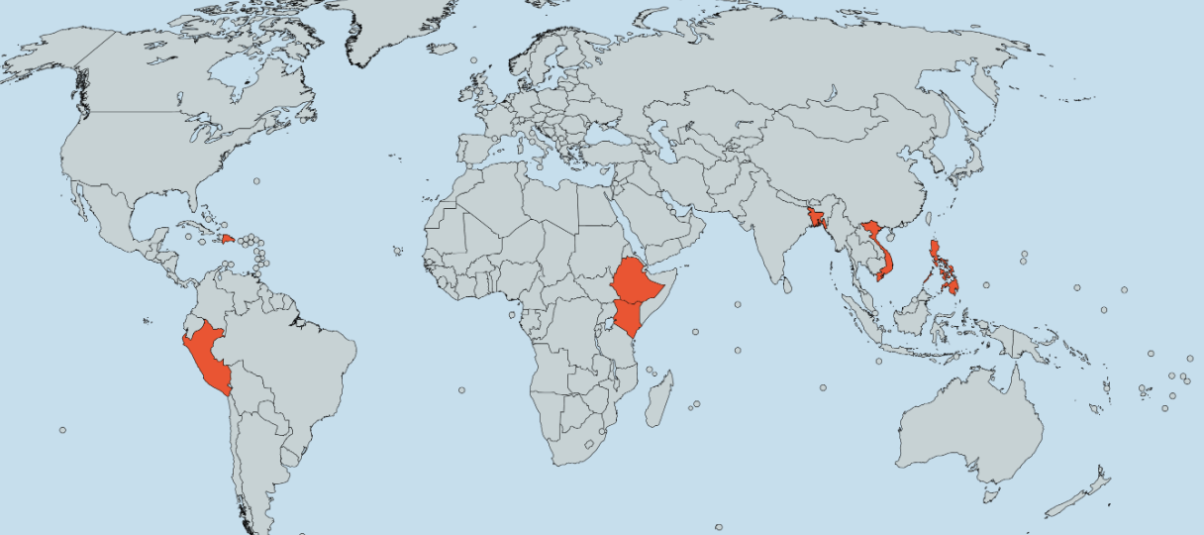
This program focuses on seven highly vulnerable developing countries
Bangladesh
Dominican
Republic
Vietnam
Philippines
Peru
Ethiopia
Kenya
Notes:
This slide shows the geographical spread of the project.
We have Peru and Dominican Republic in the Americas, Ethiopia and Kenya in SSA, and Bangladesh, Vietnam and Phillippines in Asia.
I think its important to note that these countries represent some of the most vulnerable countries globally to CC yet are countries which contributed very little to global GHG emissions.
.
Vietnam, Philippines and DR are exposed to increasing violent tropical storms and as we speak Typhoon Tisoy is laying waste to the Philippines. These countries are also exposed to sea level rise coastal water salination and destruction of coral reefs impacting on livelihoods.
Bangladesh is at significant risk of food in the Ganges Brahmaputra delta that has already displaced millions
Ethiopia and Kenya are experiencing drought and impacts on rural farmers. East Africa is also exposed to extreme rainfall events and in October 2019 we saw violent floods that displaced hundreds of thousands of people yet didn’t even make the news.
Peru has similar problems of water scarcity for farming as well as increased melting of tropical glaciers.

Slide 3
At a high level we aim to do four things
Address
barriers develop
Incentives
Share knowledge
Build pipeline
Identify
opportunities for scaling up
Notes:
This is a simplifies view of the components of the program –
identify opportunities,
Address barriers and incentives
Build pipeline to present
And share the earning

Slide 4
Country Overview: Sectors and Sub-Sectors
Country | Sector | Sub-Sector
Kenya | Energy | Cooking Fuel replacement: Promoting bioethanol for cooking by displacing kerosene and charcoal using technology and business model innovation
Ethiopia | Energy | Off-grid/Mini-grids: Supporting the development of the mini-grid sector
Bangladesh | Energy, transport | Off-grid/Mini-grid, Solar Pumps & Water transport: Developing bankable business models & investment cases for solar mini-grids, solar pumps & solar boats
Peru | Waste - Energy | Waste management & Waste-to-energy: Developing business models & investment cases for landfill gas capture & waste-to-energy.
Dominican Republic | Energy | Energy efficiency and renewable energy: Advancing clean energy deployment through improved grid codes, incentive structures and minimum performance standards
Vietnam | Energy | Renewable energy: Revising rooftop solar regulations & incentives to spur market development (e.g., third party PPAs, net metering, feed-in tariffs, and interconnection processes)
Philippines | Energy | Renewable energy: Updating renewable energy policies that enable corporates to procure renewable energy directly from the generator, developing projects with private sector.
Notes:
This next slide provides and overview of the sectors and sub-sectors by country.
The important thing here is that in all countries we are engaging in the energy sector. This came out of the scoping studies and engagements with stakeholders, and so was largely demand driven. And at a macro scale this represents what is happening in Climate Finance where the majority of funding is going towards energy sector and mitigation business models. Energy business models are generally more mature and easier to fund. This is positive for the energy sector but in some respects, represents some of the challenges of funding non-energy NDC’s particularly those that relate to Adaptation.
.

